Slide 1
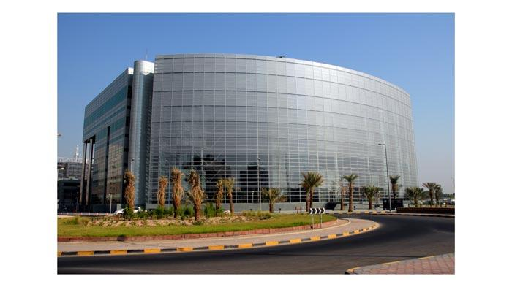
Abstract of State Audit Bureau of Kuwait in conducting the public procurement audit
The meeting of INTOSAI Working GROUP on Public Procurement Audit July 4-5 Lisbon

Slide 2
Introduction
The state of Kuwait is keen to provide the needed protection and safeguard to public fund. To activate this protection, Article No. 151 of the constitution states that .
There shall be established by law a commission for the financial control, and its independence shall be safeguarded by the law and it shall be attached to the National Assembly.

Slide 3
The law No: 30 for the year 1964 was issued to establish the State Audit Bureau:
The first article of that law confirms SABs. independence.
And the second article explains that SAB aims, basically, to perform an effective control upon Public funds through its practices and authority given by law

Slide 4
SAB of Kuwait Control
SAB started to practice its control mission as a result of the authority provided by law.
That law was convenient to realize an effective control on the public fund in that time, since it suited the nature of financial and economical positions of the state.
It also suited the control methods followed by the other countries to realize an effective control on the public fund.

Slide 5
Financial instructions (laws- circulars - decisions)
Law No. 49 of 2016 on public tenders.
Ministry of Finance Circular No. 2 of 2017 on Procurement.
Decisions issued by the Executive on procurement .
Military Articles Excluded from Law No. 49 of 2016.

Slide 6
Types of public procurement:
If the value of the contract exceeds KD 75,000, it shall be submitted through the Central agency for public tenders in away of practice , direct contracting or group purchase.
Less than 75000 KD purchase through or practice according to circular 2 of 2017.
Between 5000 - 75000 KD by Exercise.

Slide 7
Types of public procurement:
Between 2000-5000 KD are drawn five offers from different companies and The contract is signed directly.
Less than 2000KD are drawn three offers from different companies and The contract is signed directly
Through collective purchase.
Through the internal and external covenant of sector employees.

Slide 8
How we do the Auditing in SAB of Kuwait ?
First : checking by prior control .
Finally : Auditing after payment .

Slide 9
Article no 13 &14 of The Establishment of the State Audit Bureau Law No. 30 (1964) .
Supply and public works tenders, where the value of each is upwards of one hundred thousand dinars** shall be subject to the SAB prior control. In determining such value, consideration shall be given to the gross value of the articles or works under tender, calculated on the basis of minimum prices of tenders fulfilling the conditions required.
The SAB shall settle the matter and notify the authority concerned of the result within a period not exceeding seven days from the date of receipt of the tender documents and all the papers, documents, statements and explanations related to it, in full and duly completed.

Slide 10
Actions taken by checking with SAB prior control depends on:
the value of each is upwards of one hundred thousand dinars.
Circular No. 9 of 2010 regarding the limitation of the manual for the preparation of tender papers, draft contracts, commitments and agreements subject to prior control before submitting them to the Audit Bureau

Slide 11
The results of SAB prior control
unconditional approval.
conditional approval of the observations that the Authority must comply with when signing the contract.
Financial Violation
( the entity was associated before the approval of sab)
the disapproval (Refusal)

Slide 12
SAB audit reports are objective, express opinions regarding financial positions movements and give the real financial positions of the State. The reports also include evidence to prove and support SAB remarks and comments. In addition, they show the compliance of entities subject to SAB control with financial laws, rules and regulation.

Slide 13
Some of the SAB prior control notes that were noted when checking
High financial savings have been achieved.
It is confirmed that the bidder has been awarded the lowest prices corresponding to the required conditions and specifications.
The financial position of the entity is confirmed and it is estimated according to its approved financial budget.

Slide 14
Finally : Auditing after payment .
General Auditing Manual used by the SAB of kuwait :-
Make sure that you have documents that indicate the authenticity of the purchase.
The existence of the original invoice.
The receipt certificate is present .

Slide 15
Finally : Auditing after payment .
General Auditing Manual used by the SAB of Kuwait :-
The required specifications are identical to the supplied .
Ensure correct accounting guidance.
Commitment to the organizers of the purchase.

Slide 16
Override cases detected by manual checks
Cases of non-application of laws, circulars and decisions:-
SAB prior control.
Approval of the Central agency for public tenders .
Financial Approvals .
Lack of funds.

Slide 17
Division of contracts to circumvent the laws .
Failure to receive agreed quantities .
Supply without need to Supply .
In quantities exceeding the need.
Other…

Slide 18
At the end of each fiscal year, each of the Audit Bureau's observations for each of the prior control and subsequent monitoring of the annual report shall be recorded with the observations of the Audit Bureau. It shall be discussed in the Budget Committee of the National assembly of Kuwait.

Slide 19
thank you
Did by :
- M0HSEN ALDOUSARI
- MUNIRA ALHUWAIDI
- DADER ALKHUDER

